Slide 1
18PYB103J
SEMICONDUCTOR PHYSICS
UNIT 5
Characterization techniques for low dimensional systems
XRD – Powder method
Lecture 9

Slide 2


Slide 3
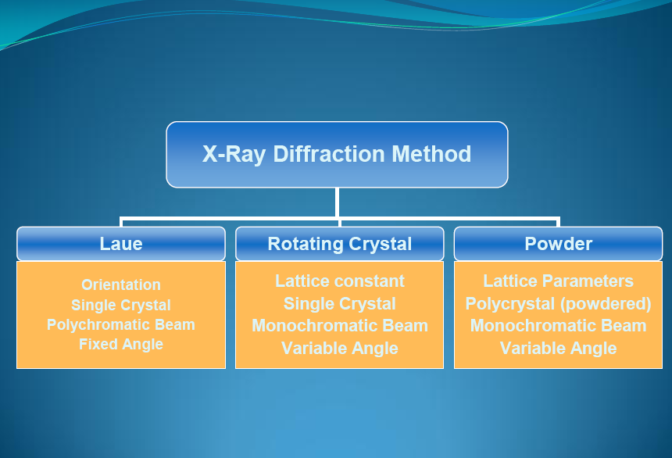

Slide 4
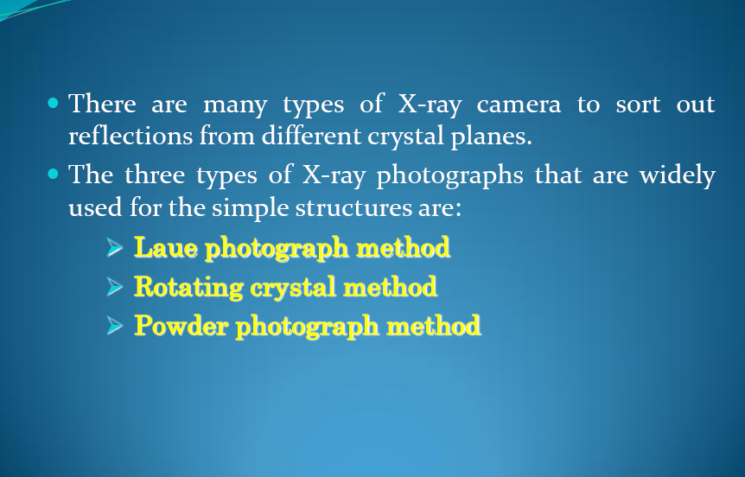

Slide 5
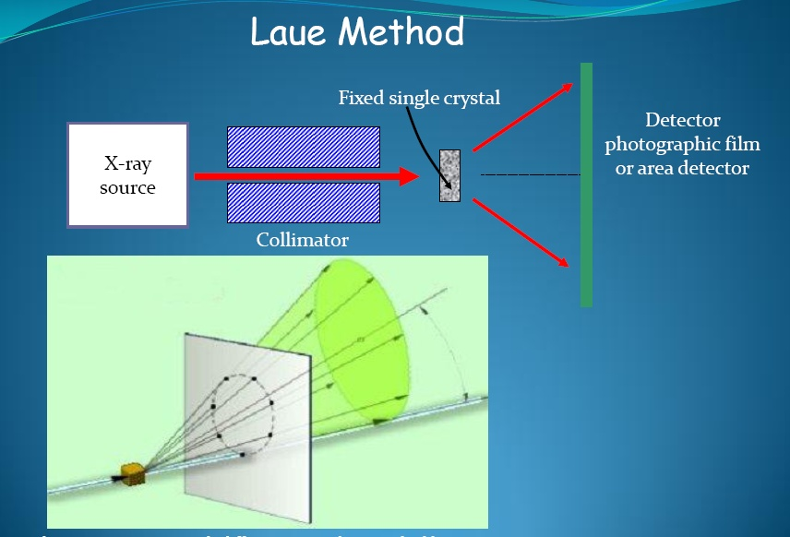

Slide 6
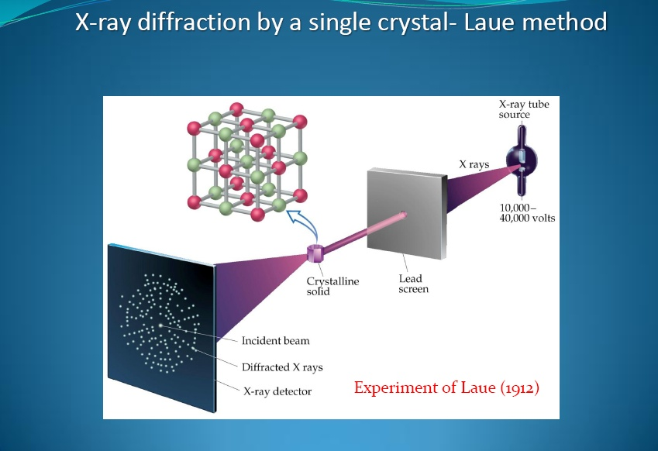

Slide 7
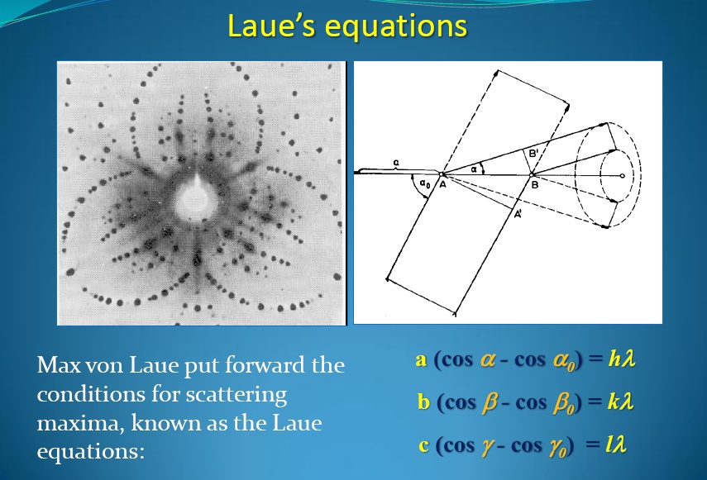

Slide 8
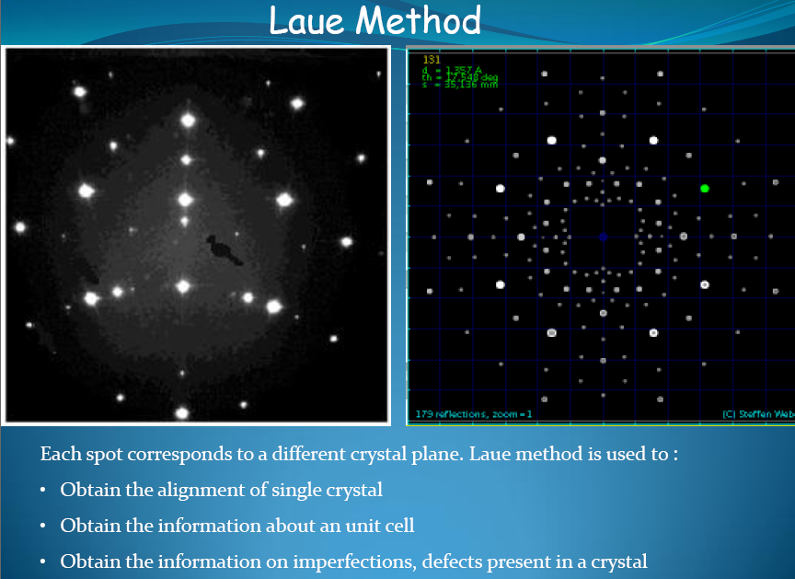

Slide 9
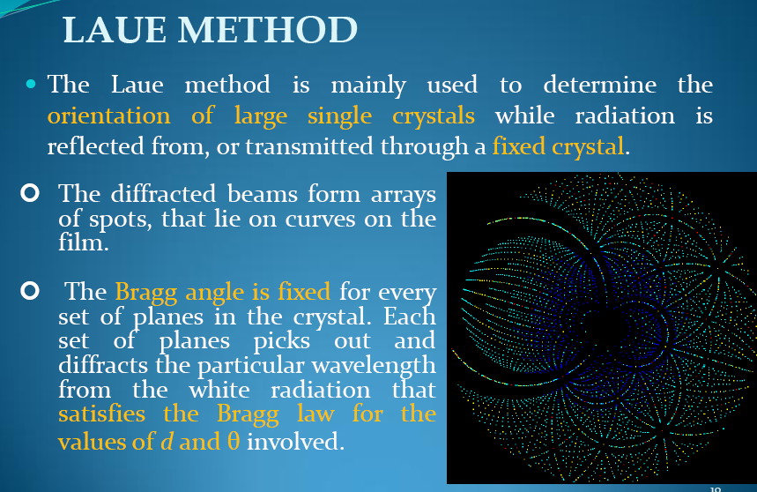

Slide 10
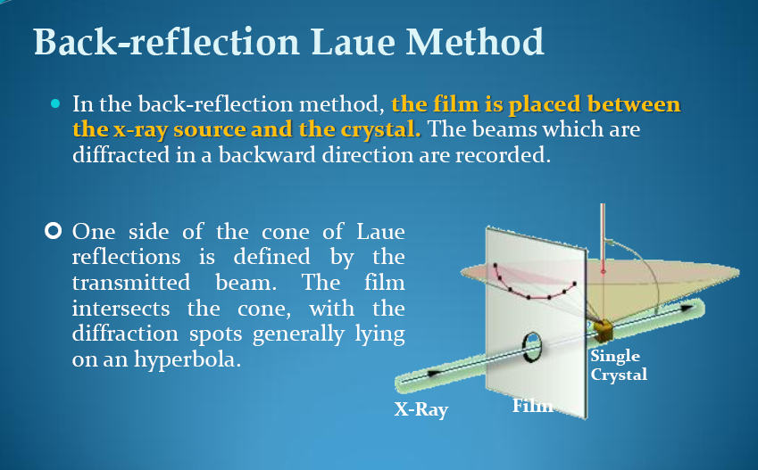

Slide 11
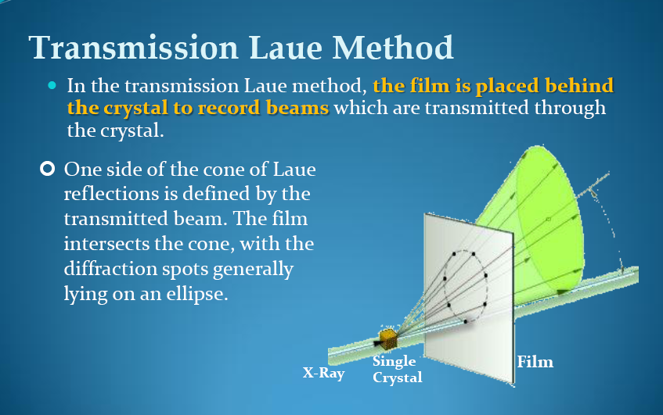

Slide 12
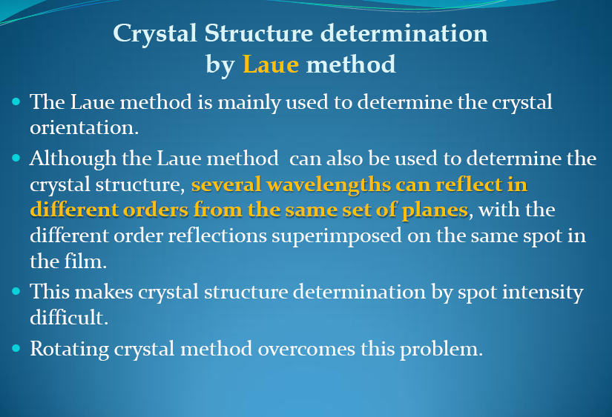

Slide 13
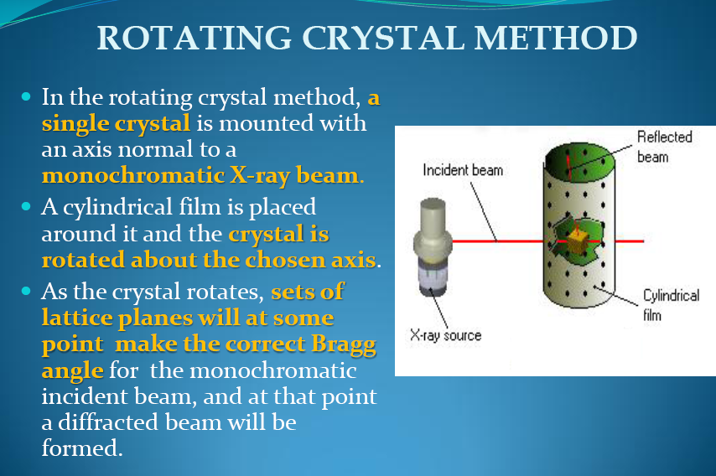

Slide 14
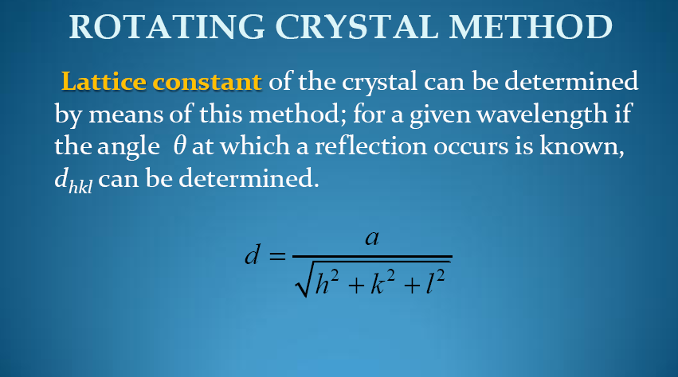

Slide 15
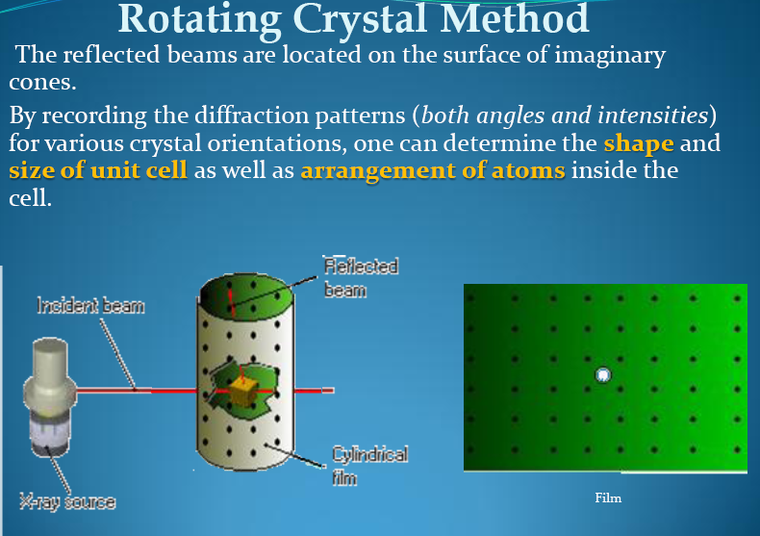

Slide 16
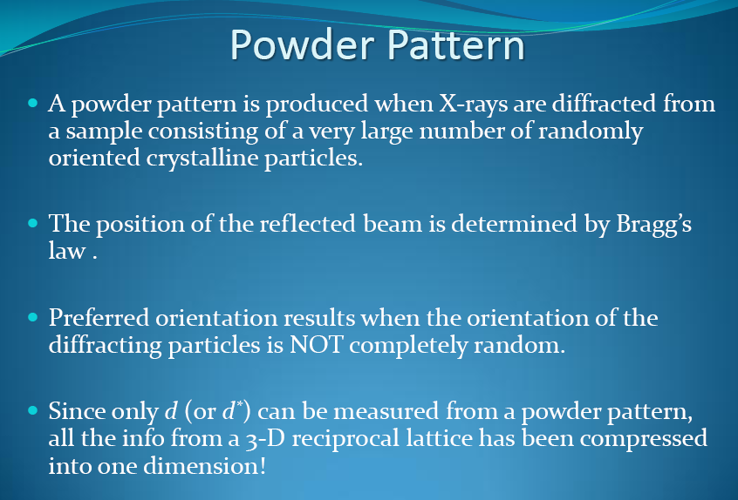

Slide 17
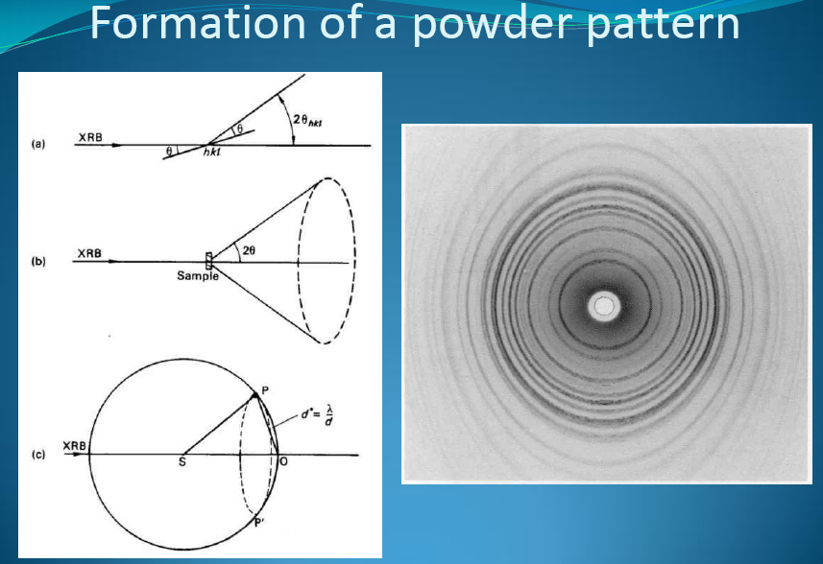

Slide 18
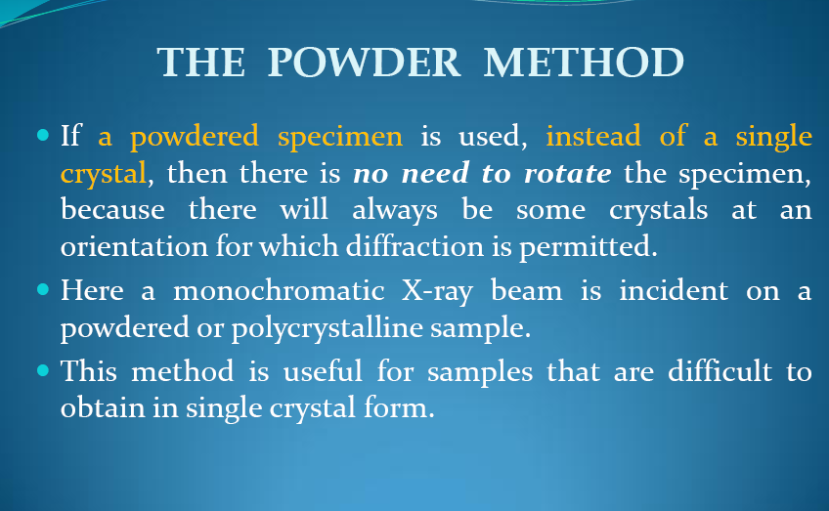

Slide 19
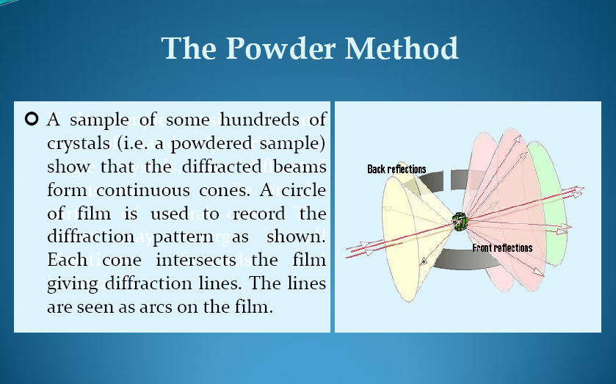

Slide 20
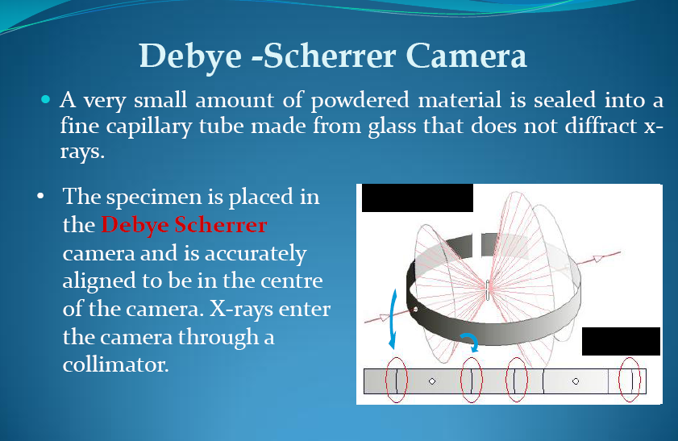

Slide 21
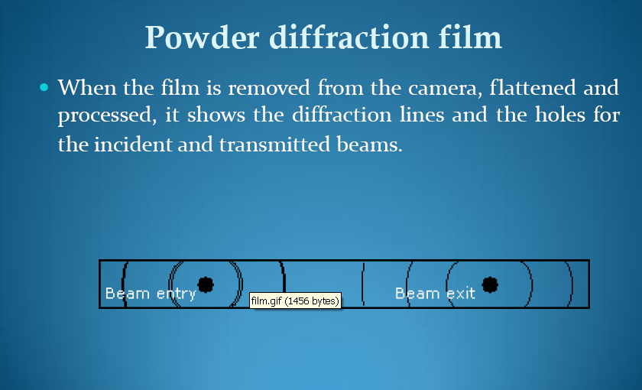

Slide 22
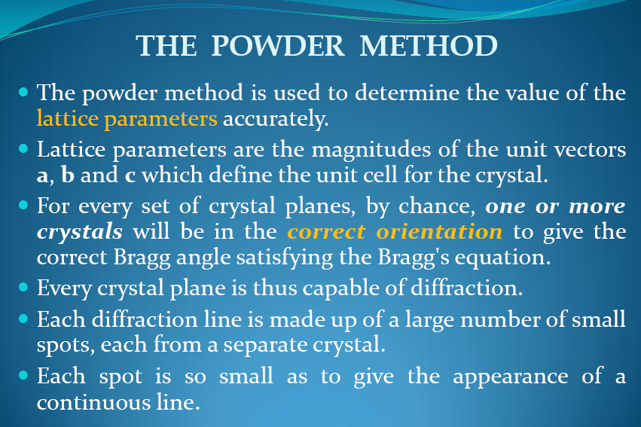

Slide 23
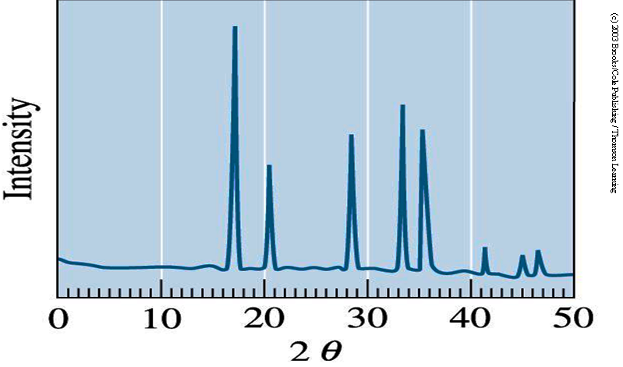
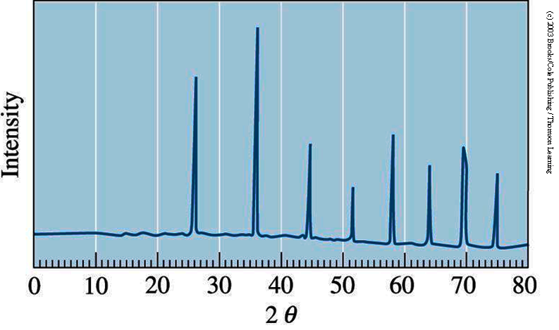
Measurement Results
XRD Pattern
for NaCl
XRD Pattern
for KCl

Slide 24
Application of XRD
XRD is a nondestructive technique. Some of the uses of x-ray diffraction are;
Differentiation between crystalline and amorphous materials;
Determination of the structure of crystalline materials;
Determination of electron distribution within the atoms, and throughout the unit cell;
Determination of the orientation of single crystals;
Determination of the texture of polygrained materials;
Measurement of strain and small grain size…..etc

Slide 25
Neutron Diffraction
Neutrons were discovered in 1932 and their wave properties was shown in 1936.
λ ~1A°; Energy E~0.08 eV. This energy is of the same order of magnitude as the thermal energy kT at room temperature, 0.025 eV, and for this reason we speak of thermal neutrons.
E = p²/2m p = h/λ
E=Energy λ=Wavelength
p=Momentum
m_{n}=Mass of neutron = 1,67.10⁻²⁷kg

Slide 26
Neutron Diffraction
Neutron does not interact with electrons in the crystal. Thus, unlike the x-ray, which is scattered entirely by electrons, the neutron is scattered entirely by nuclei
Although uncharged, neutron has an intrinsic magnetic moment, so it will interact strongly with atoms and ions in the crystal which also have magnetic moments.
Neutrons are more useful than X-rays for determining the crystal structures of solids containing light elements.
Neutron sources in the world are limited so neutron diffraction is a very special tool.

Slide 27
Neutron Diffraction
Neutron diffraction has several advantages over its x-ray counterpart;
Neutron diffraction is an important tool in the investigation of magnetic ordering that occur in some materials.
Light atoms such as H are better resolved in a neutron pattern because, having only a few electrons to scatter the X ray beam, they do not contribute significantly to the X ray diffracted pattern.

Slide 28
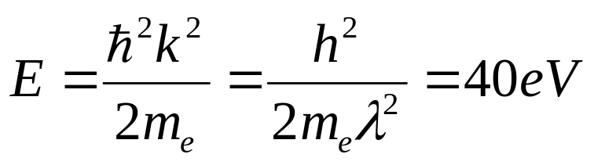
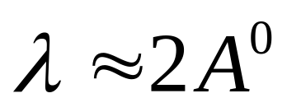
Electron Diffraction
Electron diffraction has also been used in the analysis of crystal structure. The electron, like the neutron, possesses wave properties;
Electrons are charged particles and interact strongly with all atoms. So electrons with an energy of a few eV would be completely absorbed by the specimen. In order that an electron beam can penetrate into a specimen , it necessitas a beam of very high energy (50 keV to 1MeV) as well as the specimen must be thin (100-1000 nm)

Slide 29
Electron Diffraction
If low electron energies are used, the penetration depth will be very small (only about 50 A°), and the beam will be reflected from the surface. Consequently, electron diffraction is a useful technique for surface structure studies.
Electrons are scattered strongly in air, so diffraction experiment must be carried out in a high vacuum. This brings complication and it is expensive as well.

Slide 30
Diffraction Methods
X-Ray
Neutron
Electron
λ = 1A°
E ~ 10⁴ eV
interact with electron
Penetrating
λ = 1A°
E ~ 0.08 eV
interact with nuclei
Highly Penetrating
λ = 2A°
E ~ 150 eV
interact with electron
Less Penetrating

